Slide 1
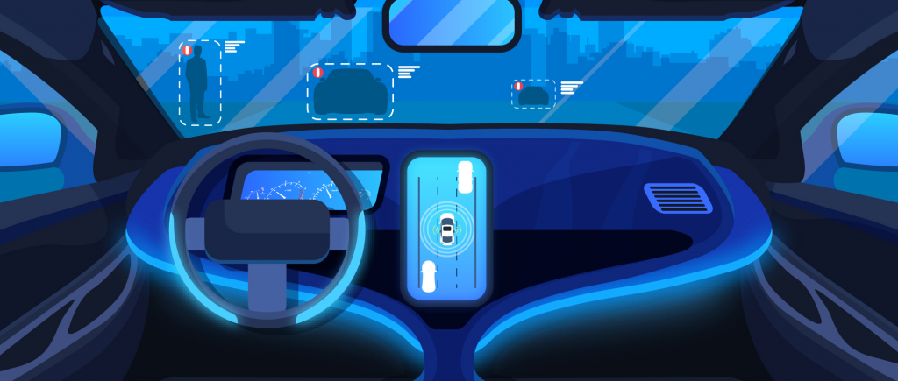
AUTONOM 2021

Slide 2

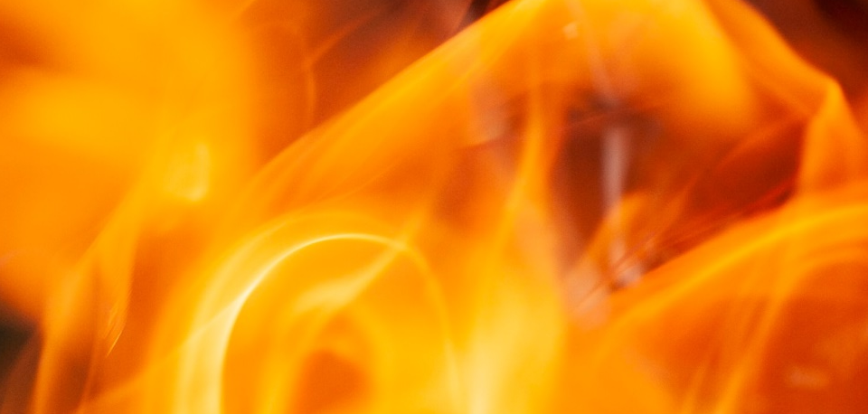

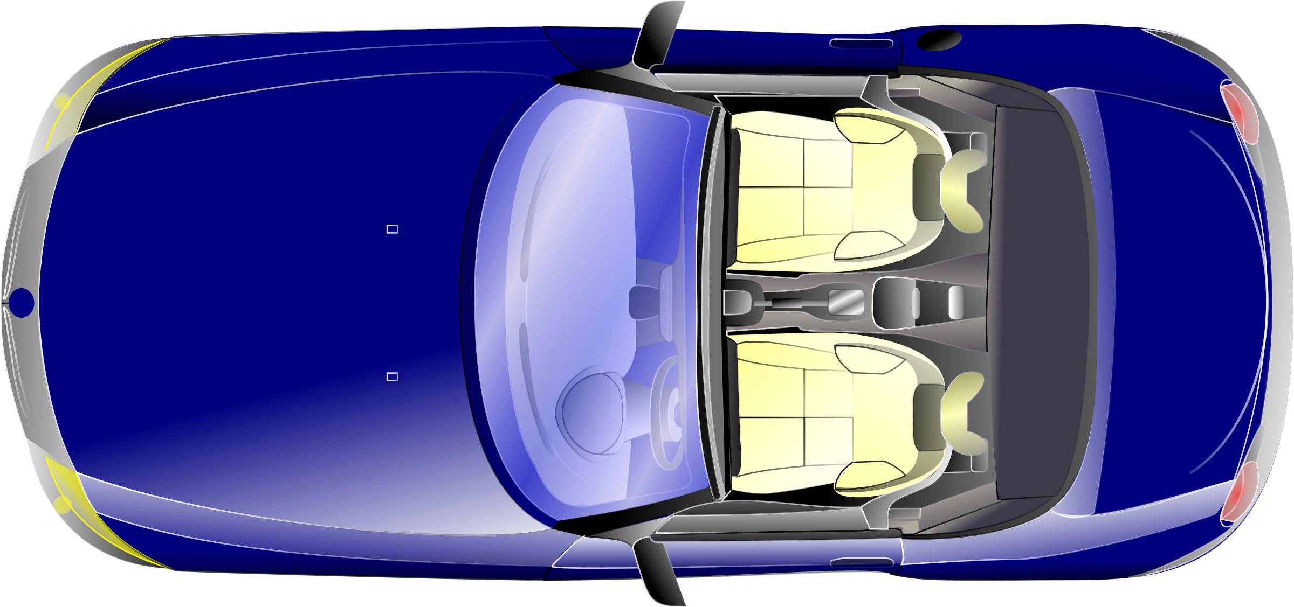

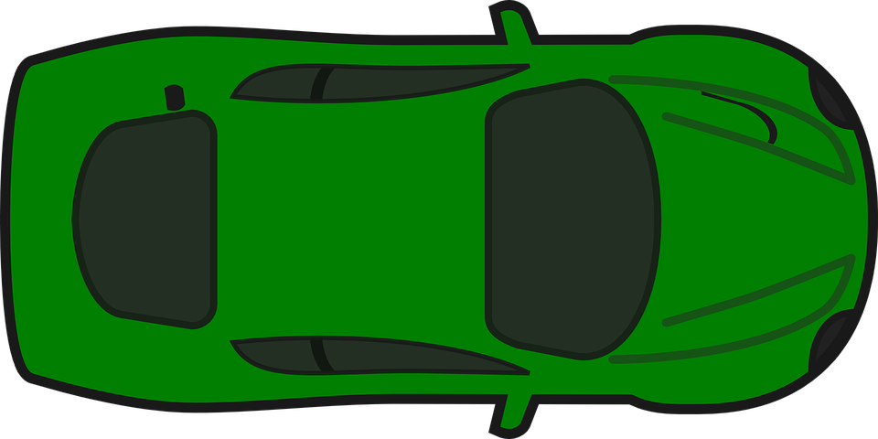
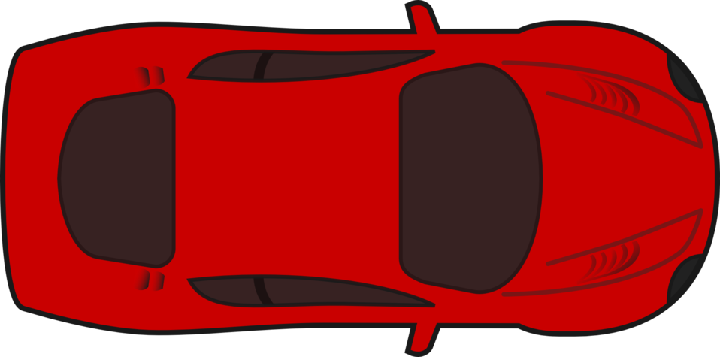
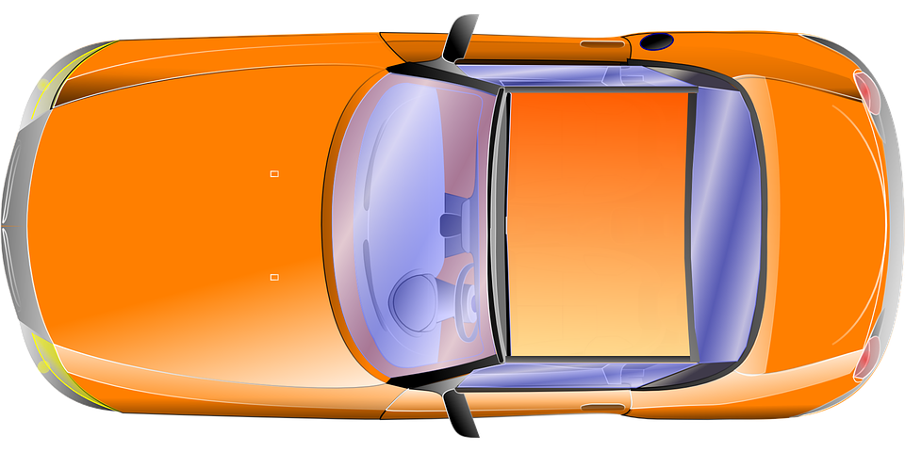
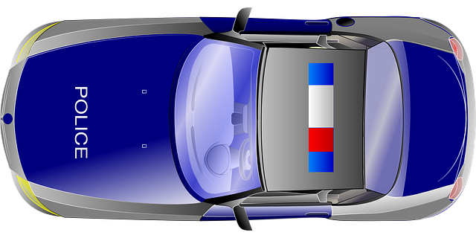
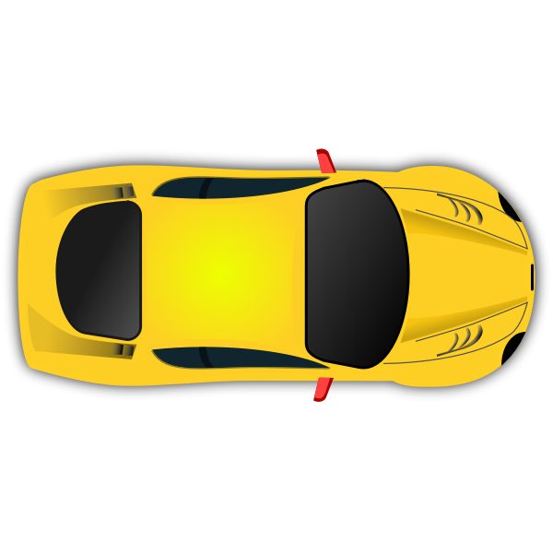
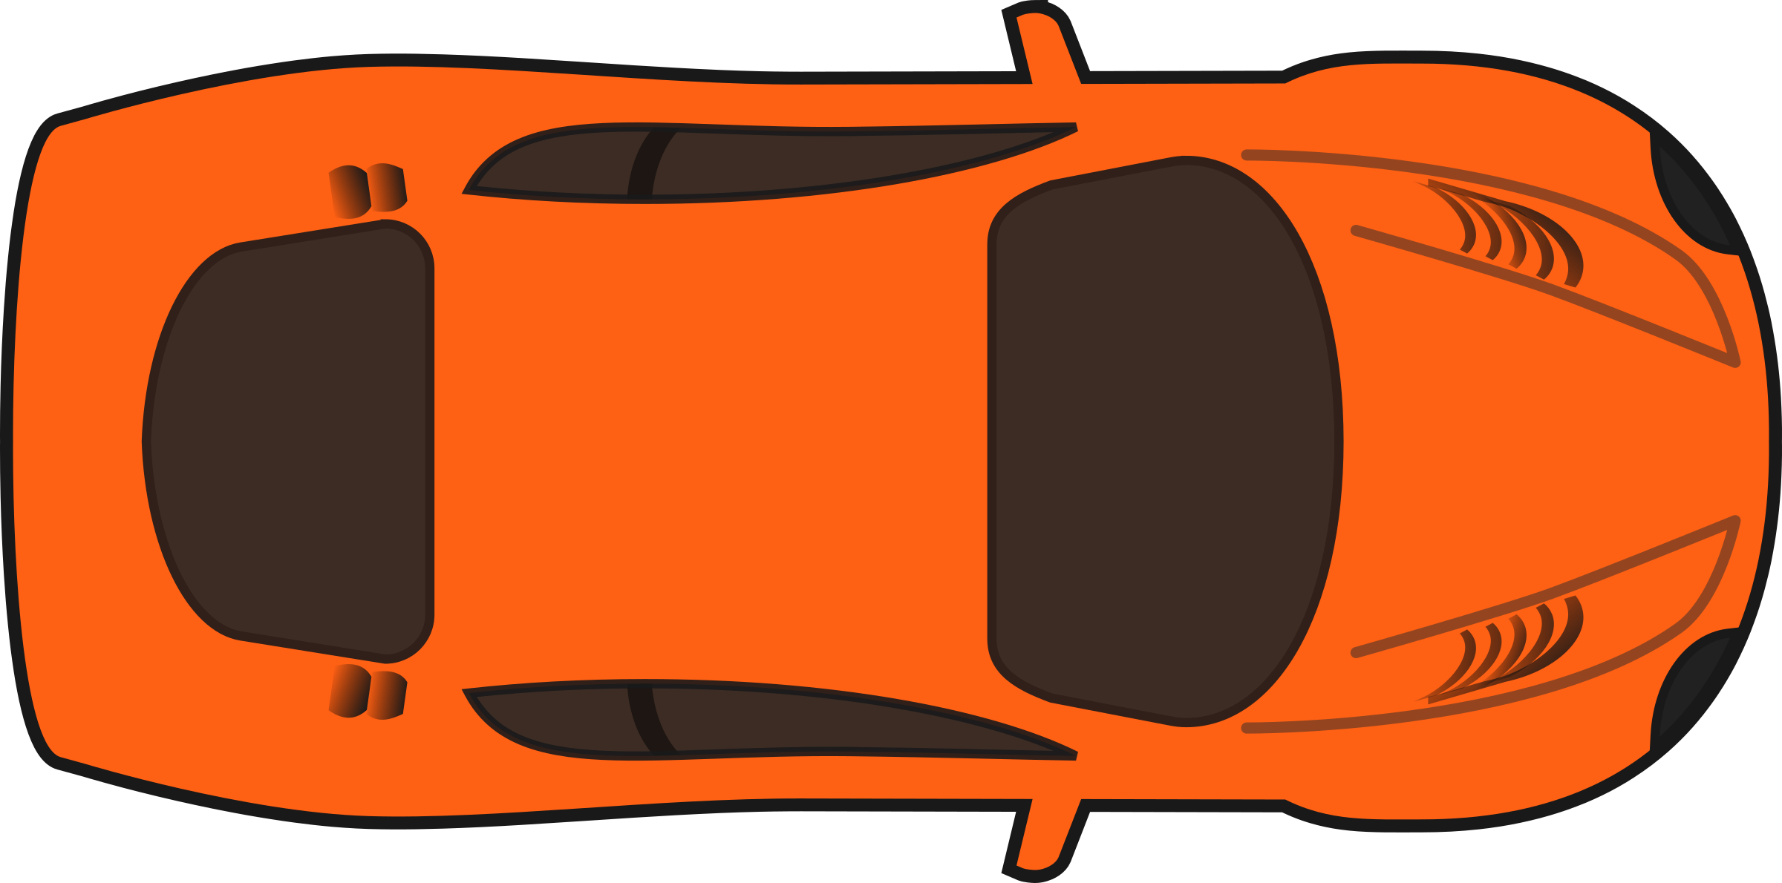
ABHISHEK DIXIT
Mechanical
AKSHAT SAINI
EEE
APOORV ARORA
EEE
DUKSH CHAUHAN
EEE
PRITI
Mechanical
MANVENDRA SINGH
Mechanical
SATYAM
Mechanical
SHIVAM
Mechanical
NIKSHITHA ELUGU
Mechanical
RAJARAM YADAV
EEE
FA
Dr. T SUDHAKAR
Dr. VINOD SINGH YADAV

Slide 3


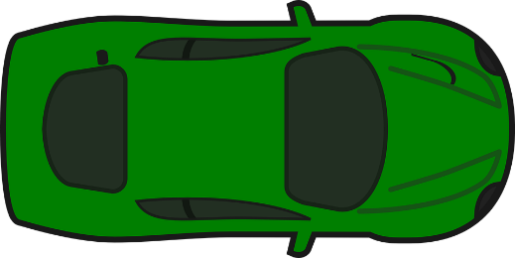
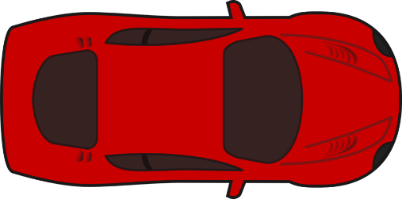
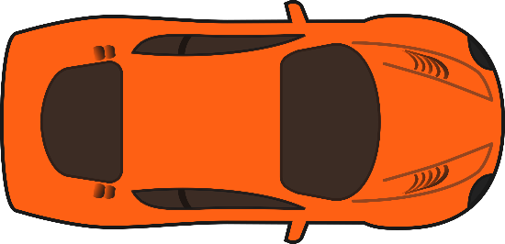
ABHISHEK DIXIT
Mechanical
AKSHAT SAINI
EEE
HILL
SPRINTERZ
APOORV ARORA
EEE
DUKSH CHAUHAN
EEE
PRITI
Mechanical
MANVENDRA SINGH
Mechanical
SATYAM
Mechanical
SHIVAM
Mechanical
NIKSHITHA ELUGU
Mechanical
RAJARAM YADAV
EEE
FA
Dr. T SUDHAKAR
Dr. VINOD SINGH YADAV

Slide 4

SCENARIO NO.
TOPIC
1 | Residential area
2 | Smart city
3 | Village
4 | Night Scene

Slide 5
5 | Delhi based Network
6 | Domestic colony connecting the Highway
7 | Junction Rush and Rash Driving
8 | Traffic and Crowd
9 | Double lane and curve road highway

Slide 6
INTRODUCTION
We have looked at Indian traffic conditions and what is the reason for accidents in India due to a smooth traffic flow disturbs . Considering some of them, we have tried to prepare our scenarios in such a way to bring out reality on this Virtual platform.
As a team we targeted to cover different aspects of Road safety by taking different real world situations in front.
Rather than Showing Collisions in our scenarios, we have put more emphasis on thinking about how an Autonomous Vehicle should react during different wanted and unwanted Situations and how should it can tackle all such challenges smoothly without any harm and disturbance.
SENERIO 1
SENERIO 2
SENERIO 3
SENERIO 4

Slide 7
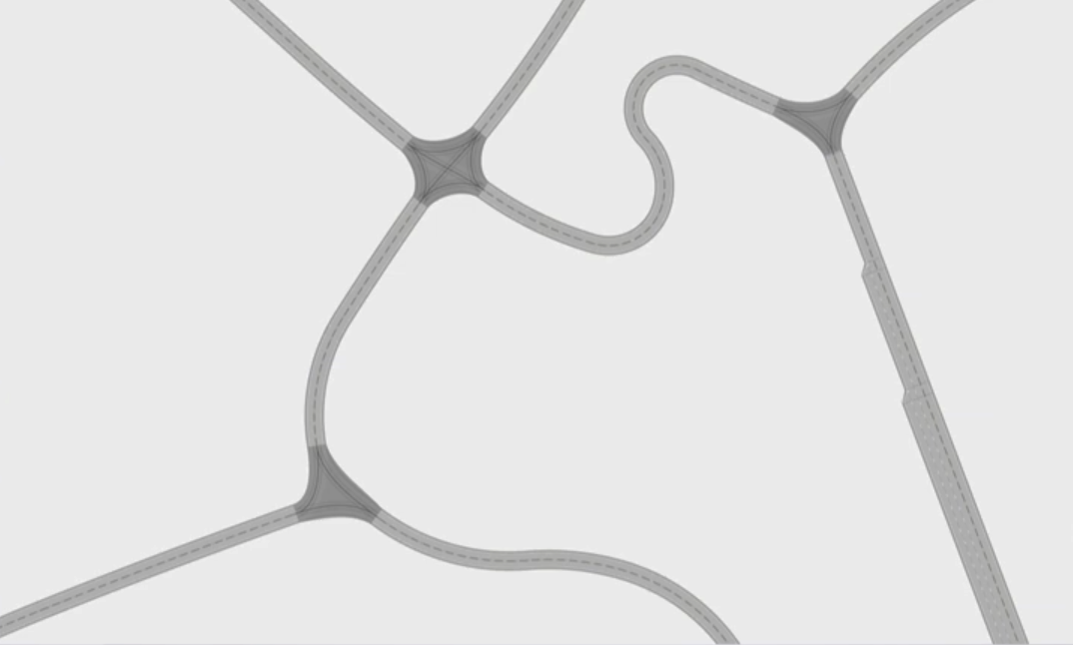
Scenario-1
(Residential area)

Slide 8
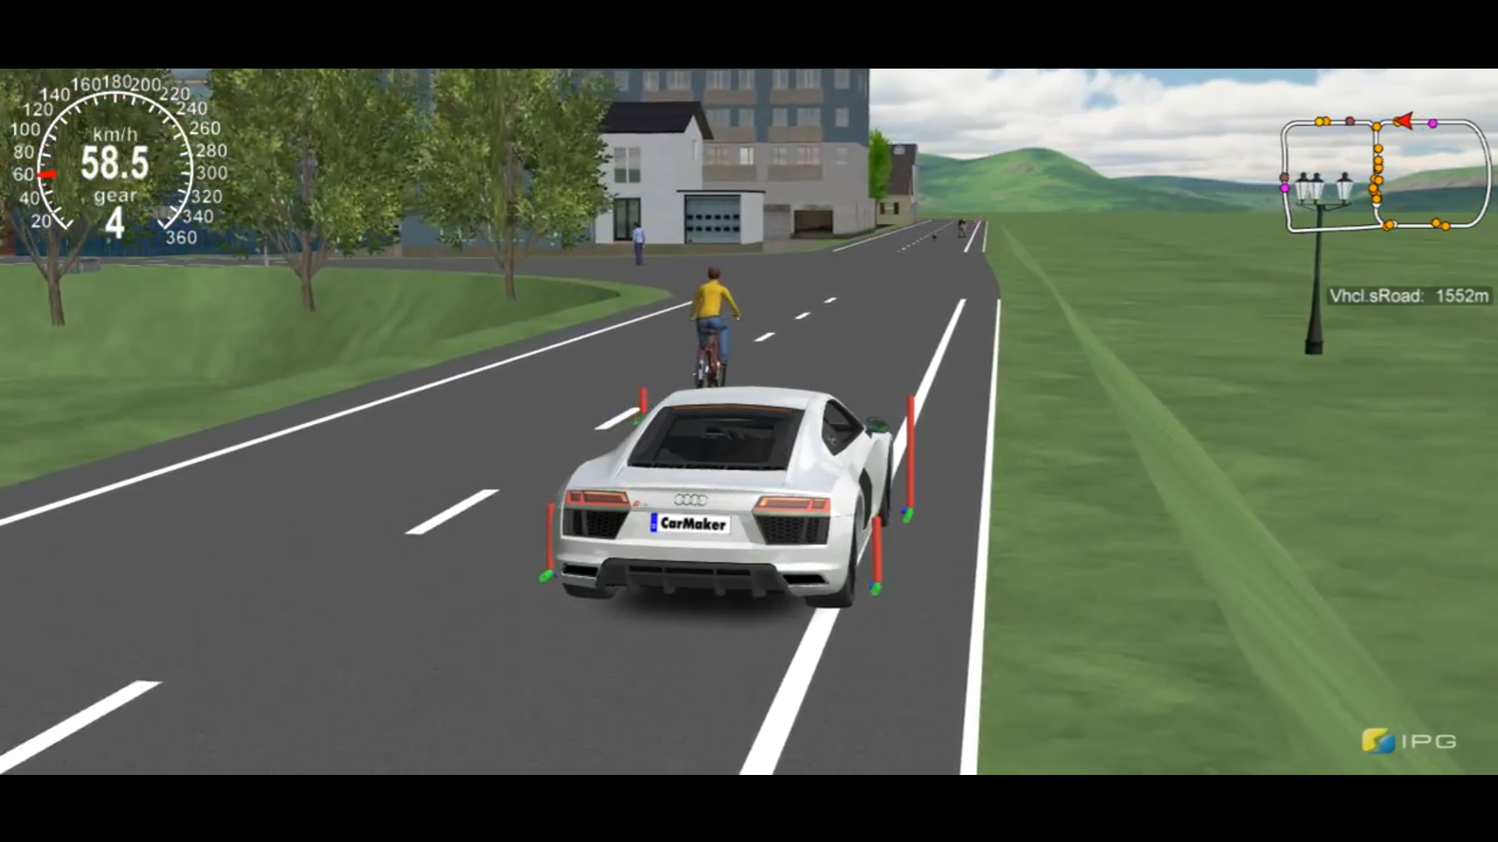
OBJECTIVE:
To create and design a realistic Residential scene with a heavy crowd and to ensure our vehicle avoids every possible obstacle smoothly in order to nullify/avoid unwanted collisions and harms.

Slide 9
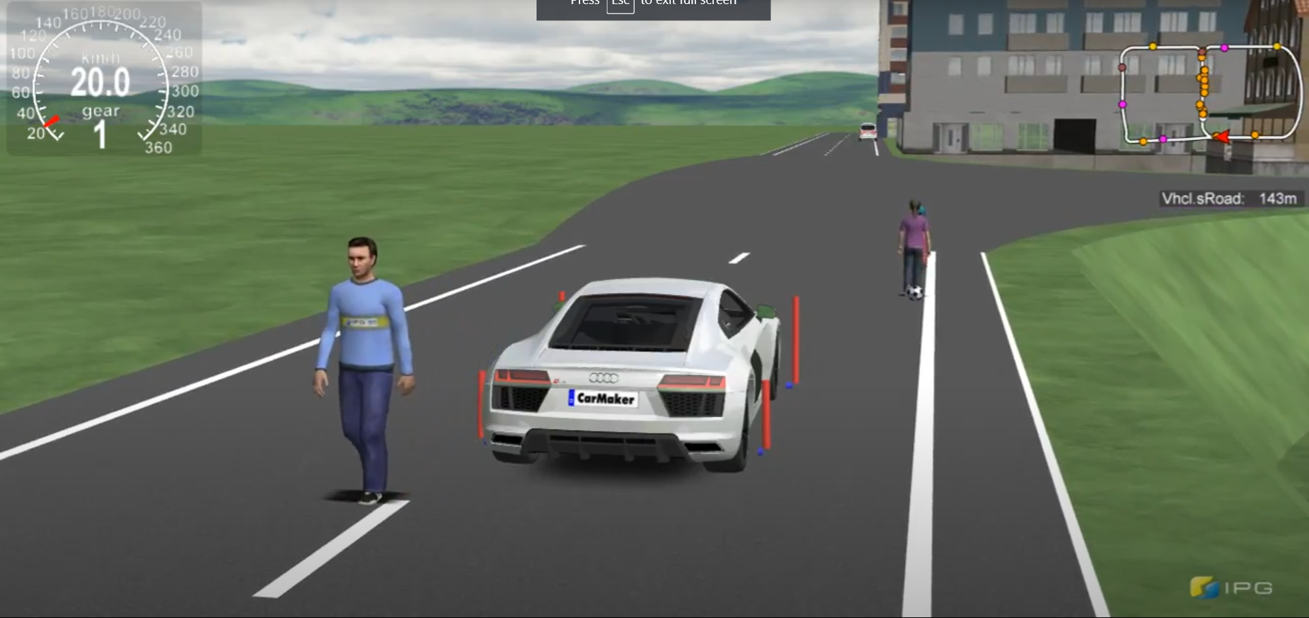
APPROACH :
During this scenario our Main aim was to picturize the virtual crowded Residential Colony including Parks, Pedestrians, Pets, Local Sellers roaming around the colony which act as an obstacle to a flow of traffic and can cause unwanted accidents.
Changing lanes or reducing the speed of the vehicle whenever traffic in a particular lane increases.
Shown Childrens playing, Carts roaming, Peoples talking, etc.
Reducing the speed of the car by 60-70% at the turns and junctions.
Slowing down whenever a pedestrian or animals cross or are near to the track,increasing the width of the lanes .
Considering all the traffic rules/signals ,speed limits to avoid accidents or traffic congestions.

Slide 10

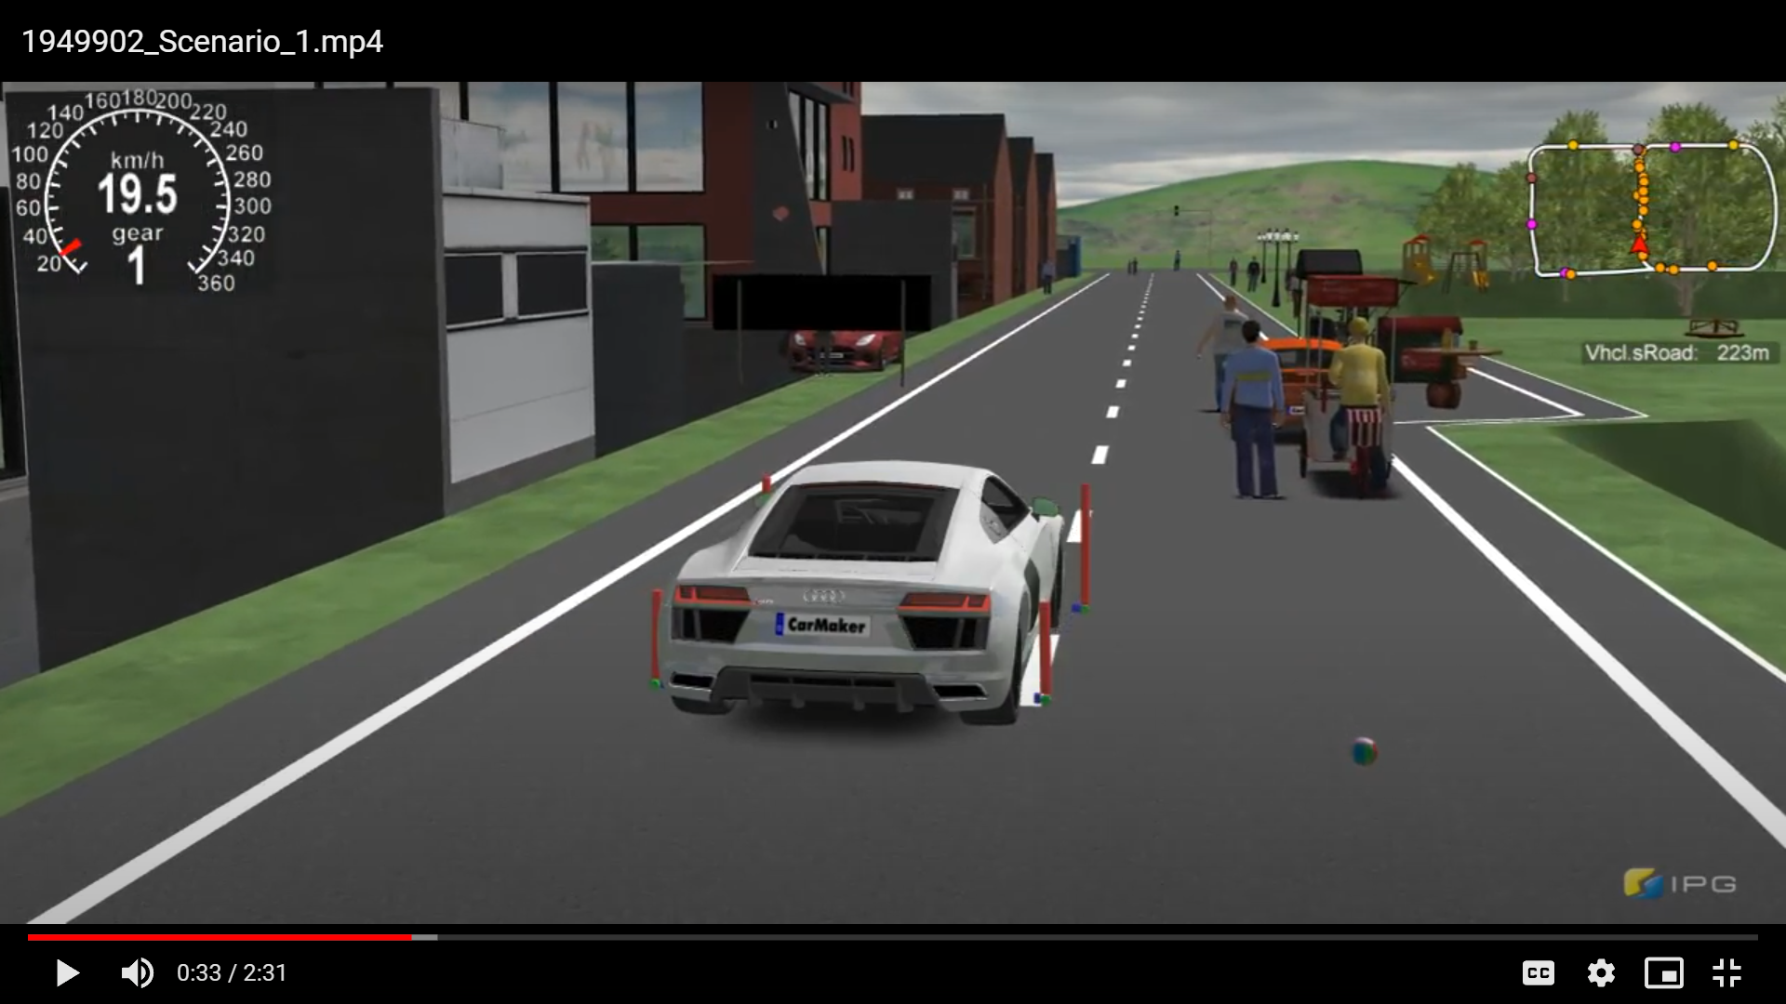
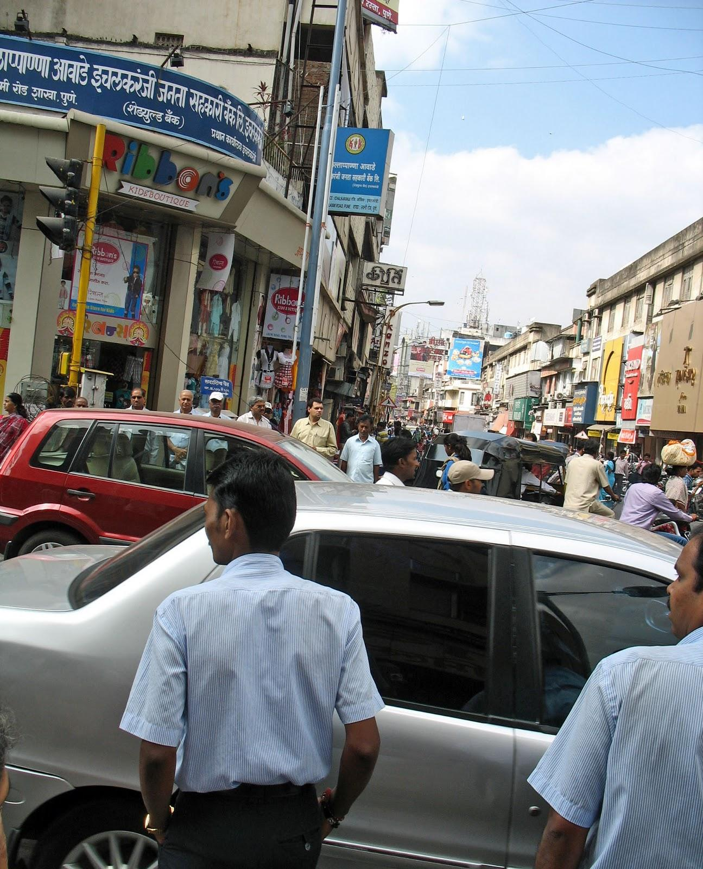
AUTONOM
IDEAS:
We have tried to go deeper into the Root Cause of traffic congestion in the cities and suggested some solutions. Some solutions are implementable with the help of technology, building new infrastructure and some solutions have to be driven by Government (Local/State Level/Central).

Slide 11
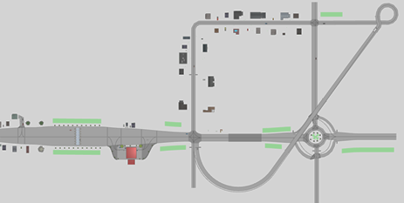
Scenario-2 (Smart city)

Slide 12
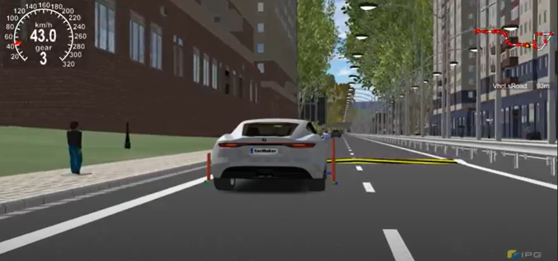
Objective:
To depict a virtual smart city scenario Using different IPG tools and to frame different wanted and wanted Situations an individual can face using the visual tools. Also, to show all possible Road safety measurements a Smart City should include.

Slide 13
Approach:
To show a connection between a developed and rural area with all appropriate possible virtual tools to depict a better view of scenario. Used Multi Route Traffics, Traffic Signals, controllers, Toll Plazas, Diversions, Street lights, etc. for better visualization of a smart city.
The main idea was to design a smart City with all basic road safety aspects which further connects to a local rural region
Shown Toll Plazas, Gas pumps, wider lanes, Buildings, offices, parking area to depict a better picture of a smart city
Used Stop and speed Controllers to control the traffic and user vehicle.
Shown proper functioning of Traffic signals in order to avoid unwanted collisions and problems.
Traffic maneuvers were set in order to provide a realistic approach.
Suitable Bypass roads, Markers, Indicators were used to show a better developed scenery.

Slide 14
Ideas and Reference:
Simulating different inbuilt samples in order to get aware of some unknown tools.
Case studies of major smart city Road obstacles and problems faced by peoples and to think of a solution to counter the problems smoothly,
To build up a smooth and effective runway for ADAS vehicles.
Studying IPG manual to understand basics of speed and stop controllers

Slide 15
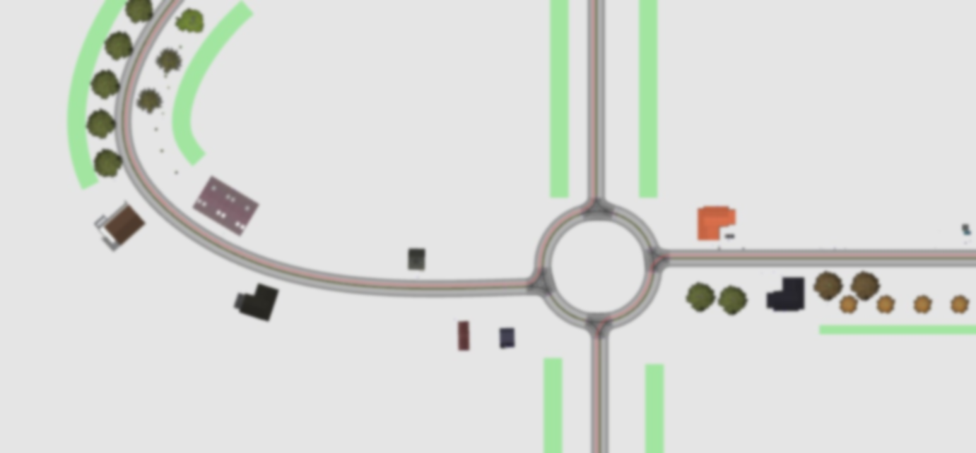
Scenario-3
(Village)

Slide 16
Objective:
To Create and design a realistic Village scene Considering all Possible Road Obstacles and challenges that a person can face and to counter all such challenges smoothly without any collision possibilities using Virtual Tools

Slide 17
Approach:
During this particular scenario, we focused on providing the virtual view of a village considering Dirt roads, Roaming Cattles, Villagers, Farming fields etc. There We focused on creating different general day to day life challenges a person can face during a village ride and finally targeted to counter all such unwanted situations successfully.
Using Dirt road or Kacha road to bring up the reality of some villages on a virtual platform.
Shown random Mud pits, cattle's, bumps, carts, pedestrians, etc.
Counter reaction of a vehicle against obstacles such as random rocks, herds, human crowds etc.
Ignorance of road markings, signals, Indicators etc. to put some real values to a village road scenario.
Suitable offsets and Maneuver were provided in accordance to situation demand.
Focus on the fast reflexes towards the unwanted random village situations.

Slide 18
Ideas and Reference:
India is a huge country with a large portion of rural area which has been an underdeveloped aspect of our society and an important one too, hence we can’t leave without considering it.
Members having Experience with SAE BAJA and other SAE events helped the team to consider an important aspect of Indian roads reality.
Design and framing of a village scene using Google Earth, personal Experiences and previous Works.
IPG Samples are a huge source of information as they allow an individual to think widely.

Slide 19
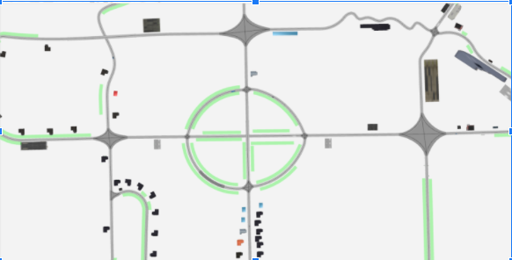
Scenario-4
(Night Scene)

Slide 20
Objective:
To Construct and design a virtual NIght scene and appropriate road network by considering maximum possible circumstances which leads to accidents during night, supported by some possible Traffic accessories which are available in IPG CarMaker.

Slide 21
Approach:
The scenario is mainly focused towards creating the night scene with less crowded streets. Essentially well lighted broads, spacious lanes, connecting bridges, road markings, navigation boards, road signage has been added.
Purpose of tackling the problem of Traffic signs, traffic lights cones & speed humps,barrier systems during night.
Controlling the speed while crossing the Residential area and while crossing the turns and major junctions.
Shown Accident scenes which hasn't been yet watched out due to night which we can commonly notice.
Following all the possible measures to work on the safety of the pedestrians and roadside hindrances.
User Driving with carefully at has been an highlight of the scenario to avoid the any harm.

Slide 22
Ideas and Reference:
Profiling road accidents by road category, type of impacting vehicle, type of collision, age of victim, gender and road user category https://morth.nic.in/sites/default/files/RA_Uploading.pdf
Causes of Road accidents during night http://jhtransport.gov.in/causes-of-road-accidents.html
Study conducted by MGM medical College in which it has been told that when and where accidents often occur.
Reasons to show why there are so many road accidents in India.
To counter each and every problem a vehicle can face in such a situation.

Slide 23
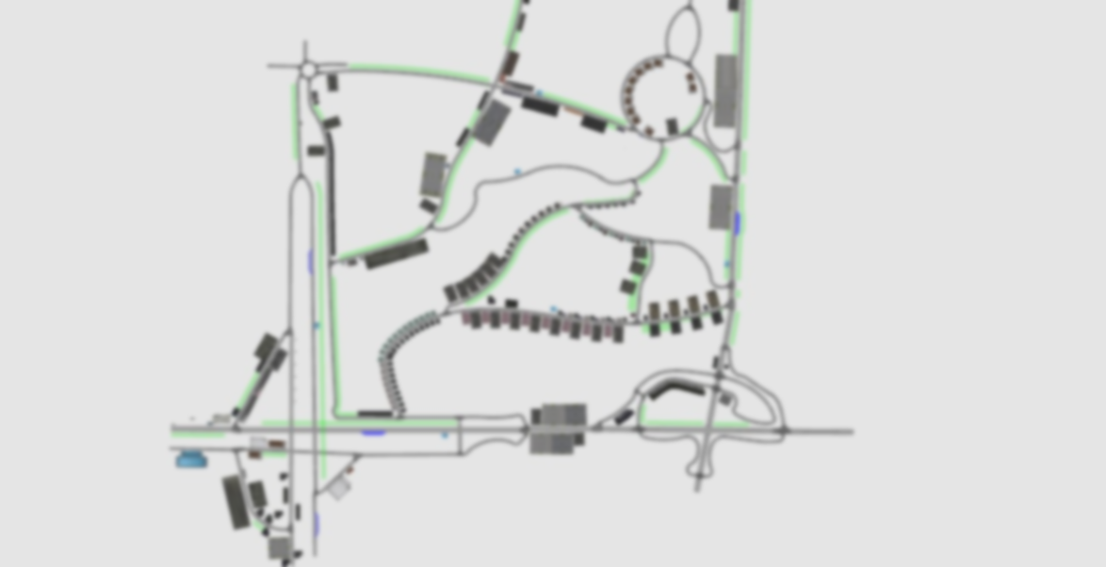
Scenario-5
(Delhi based
Network)

Slide 24
Objective:
To show and generate a realistic 3D virtual simulated road network with some common situations and how to avoid them by following some directive measures. The Real Road Network from Delhi AIIMS has been used in this project.

Slide 25
Approach:
In this scenario we have mainly focused on the road networks and this particular road network represents a block near to AIIMS DELHI.
The reason behind the selection of this scene was to focus on the issue that the major issue of traffic congestion and traffic issues can be avoided as done in the scenario.
Building a road network which has flyovers, ring roads, major four-lane highways, ramps and many more.
Major Approach was to work on real network and think of the ideas in order to improve its efficiency in terms of road safety.
Showing speed bumps and traffic lights/signs for avoiding any sort of accidents and collisions.
Including parking lanes near the highways so that it could give enough space to the other vehicles or could help in reducing the traffic congestion during peak hours.
By including steep curves and slopes which could be a reason behind accidents, thus our vehicle reduce its speed by almost 70% while crossing such curves.

Slide 26
Ideas and References:
We have created this type of scenario because it is based on a real route which actually exists in India
We got the idea to make such a route in this scenario from Google Maps. And we read the data of accidents of a block near Delhi AIIMS Hospital
As we know that in areas like Delhi where traffic jam is a major problem which causes other difficulties. So we found an important aspect to make a scenario over such a place

Slide 27
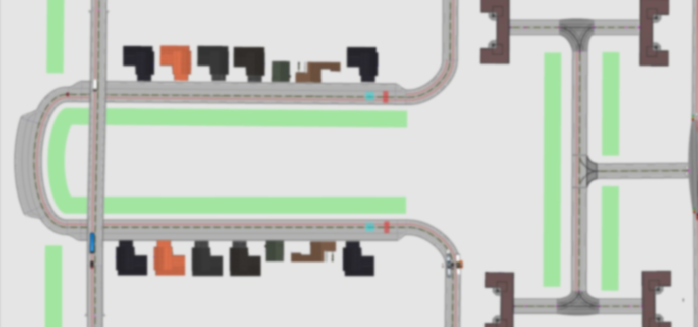
Scenario 6
( Domestic colony connecting the Highway )

Slide 28
OBJECTIVE:
To generate and devise a 3D virtual model of street and highway infrastructure with some usual impediments and how to evade them by upgrading the Indian road networks, by means of ipg CarMaker and To counter real life road obstacles during a residential travel.

Slide 29
APPROACH:
In this scenario we worked on a very different approach to avoid major accidents while overtaking a vehicle or and road objects and by improving the Indian road networks .
Improving the road infrastructure by adding parking lanes ,flyovers ,tunnels ,bridges , footpaths for the pedestrians, speed breakers before schools or important buildings.
Using proper barricades for defining the construction area
Taking special care of the traffic signs and ensuring road safety in every way possible.
In this scenario we tried covering all the objects on the road and made them view as boxes to our car sensors so that we could maintain a good distance while crossing them hence working on major causes of accidents.

Slide 30
IDEAS AND REFERENCES:
We have mainly talked about Solutions to avoid unwanted circumstances in this scenario while been in a Colony with heavy rush of commoners.
We've added schools and buildings to make the scenario a little more realistic
We have added accessories like traffic light, bridges, sidewalk, barricades etc. to bring down the accidents and to design a good framework network of roads.
https://thecityfix.com/blog/8-ways-to-reduce-road-fatalities-using-the-safe-system-approach-nikita-luke-anna-bray-sharpin/
Have taken the help of Google map to make a good structure of roads.

Slide 31
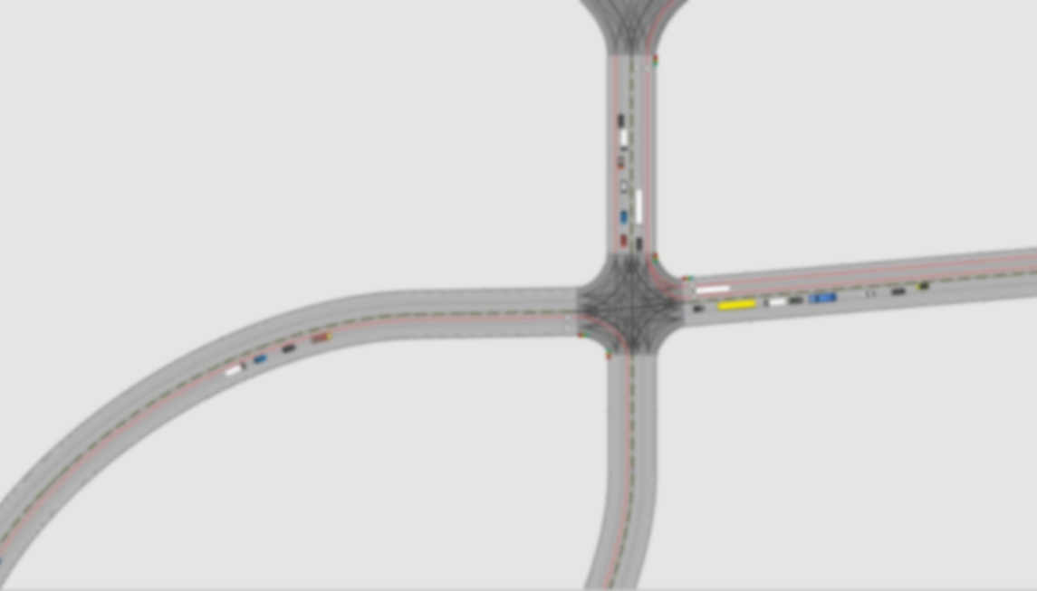
Scenario-7
(Junction Rush and Rash Driving)

Slide 32
Objective:
To Emphasize on the traffic rush that we face at the junctions during our day-to-day life. To show the immature overtaking, Signal breaking, Traffic rules avoidance, etc. which can lead to some Unwanted results but even in the worst case, programming our ADAS vehicle in such a way that it may avoid or show fast reflexes towards those unwanted challenges.

Slide 33
Approach:
In this particular scenario our team focused on putting the realistic challenges that we face during our daily life on the junctions while moving from highways to the city area rather than creating complex road networks.
To show the behavior of a car while following a path on the highway.
Shown Technically wrong Overtake at the traffic signal in order to show the immature behavior of the driver which is something we spot regularly during our travel.
To show the accident scene and its effect on the normal flow of the traffic sometimes which leads to traffic jams too.
Adding up the rash driving from some drivers on the road and user reflexes towards those tough challenges.
Speed control according to the Crowd and traffic.

Slide 34
Ideas and Reference:
The main idea for this particular scenario came through the personal experience and group discussions.
Rather than working on the complex road networks like we have done in our other scenarios, this time we emphasized more towards putting the real life problems in front.
Like our other scenarios only, here also we have emphasized on tackling the tough and instantaneous challenges without any harm rather than showing the
The reports which show that the busy junctions are the major obstacle btw the normal functioning of the traffic flow, specially in the rushed cities like Delhi, Bombay, etc.

Slide 35
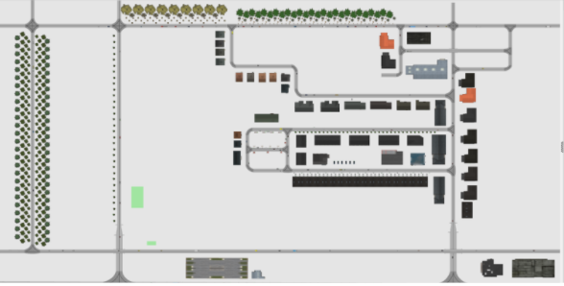
Scenario-8
(Traffic and Crowd)

Slide 36
Objective:
To create and design a virtual road network using ipg, in which the small blunder by the driver can cause the accidents risk, it has been shown.

Slide 37
Approach:
In this scenario we have tried to visualise the busy streets of a city where there are a lot of instances for an accident to occur only due to the lack of knowledge of the traffic signs .Here we have tried to maintain an average distance from the traffic ahead to avoid collisions and various other methods.
Keeping the road network simple but busy we have tried to maintain a distance of almost 3-4 secs from every vehicle in-case if there are sudden brakes we would have enough time to avoid accidents.
Changing the speed according to the amount of traffic and even in turn and at junctions.
Also kept the lanes wide enough that our car do no enter a wrong lane while overtaking .
Adding up the rash driving the some drivers on the road and user reflexes towards those tough challenges.
Used heavy traffic in order to show the view of the major city entrances and exits.

Slide 38
Ideas and Reference:
We have made this type of scenario because every time bad routes, weather, etc. are not only responsible for accidents. Sometimes driver's carelessness or even a small mistake can lead to a major accidents. We have taken this idea from here.
Crossroads are shown, people are seen standing on the side and basic infrastructure of buildings is shown around the roads. So that our scenario can represent a real world situation in a better way.
According to ministry of road transport and highways transport research wing the risk of accidents increases due to lack of basic traffic knowledge like in India it is right to walk on the left side but if someone is walking on the right side then the chances of accidents increase.

Slide 39
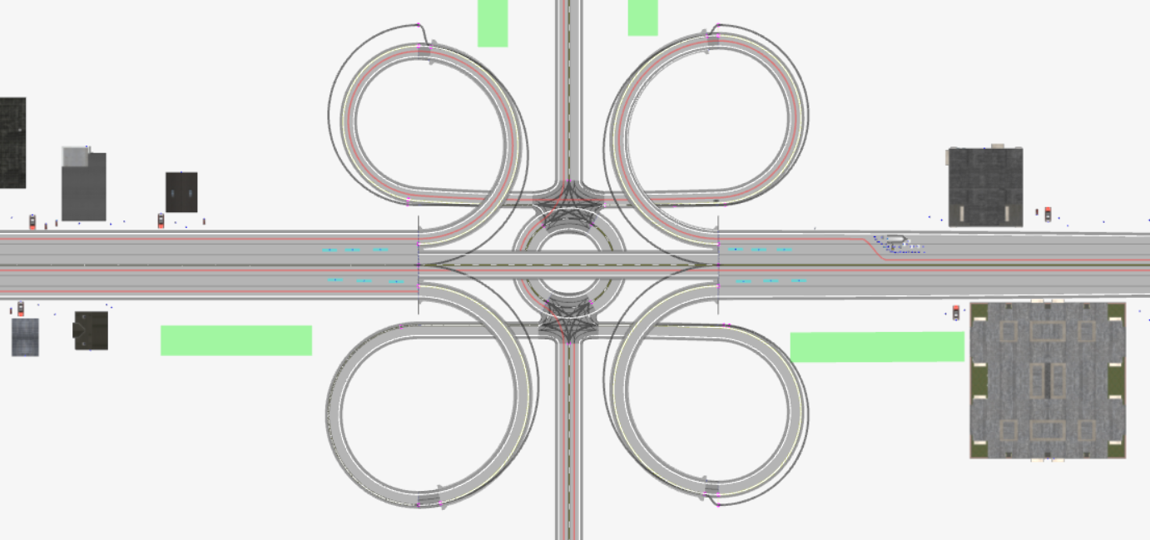
Scenario-9
(Double lane and curve road highway)

Slide 40
Objective:
To work on the Road Network Specially, to bring out modern Ring Road highways concept to connect different cities on this virtual platform and to devise a simulated 3D Highway scenario with some frequent and common obstacles that a vehicle can face. To nullify the probability of some common accidents that usually happen on such interconnected roads and complex junctions and to oppose such possibilities using Suitable ADAS Reflexes.

Slide 41
Approach:
In this scenario, we have featured smart highways, Bypass and flyover networks in which mishaps usually happen. And hindrances that face many vehicles like construction site, heavy traffic, etc. Along with tunnel roads, Double lanes and curve flyovers. by using possible virtual tools.
Showcased Tunnel Roads Showcasing Smart and Good Road Networks
Flyover is shown which is connecting 2 different roads in short path
The construction site has been shown which is on the roads sometimes
Double lane networks have shown which is depicting a good and big network of highway.
To show the Speed control during Steep curves which has a huge accident risks.
Used heavy traffic in order to show a reasonable view of a highway

Slide 42
Ideas and Reference:
Atal Tunnel, which has been recently built by the Indian Government, so the idea to add the tunnel came from there
And as we all know that Yamuna Expressway is a famous road network in India which is a multi lane road network. So the purpose of adding double lanes and ring roads in this scenario is that we are showing our network which is related to real highways in India.
Have taken help from Times of India report in which it has been mentioned about accidents happening in steep curves.
https://m.timesofindia.com/city/hyderabad/danger-ahead-steep-road-amp-blind-curve-sends-drivers-into-death-spin/amp_articleshow/59554171.c
Many times accidents happen due to the construction site being on the road, because the drivers are not able to reduce their speed and get confused which leads to an accident.

Slide 43



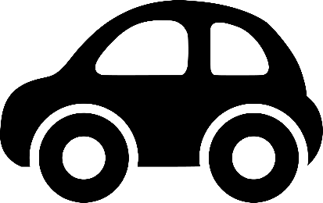
AUTONOM2021

